Slide 1
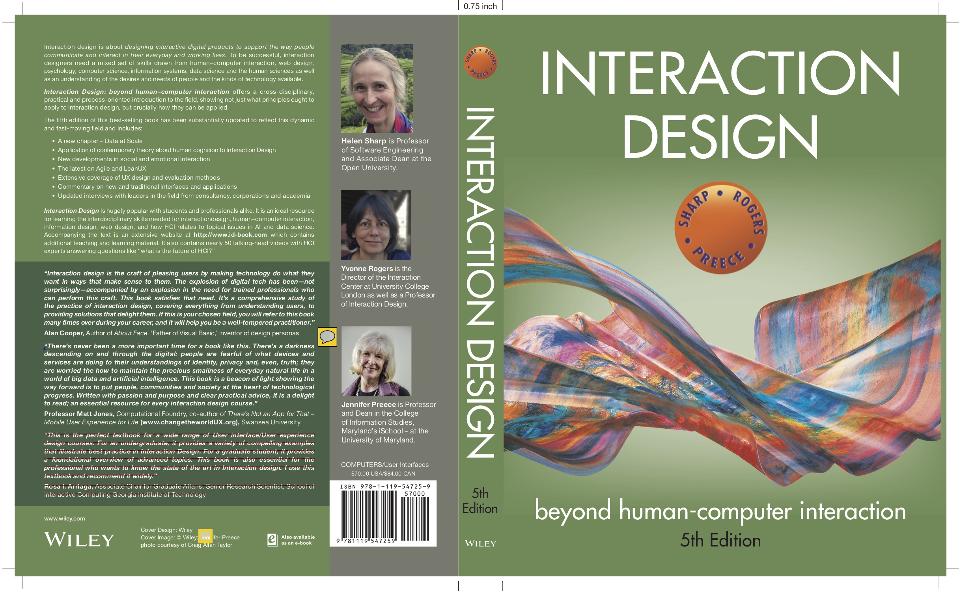
Chapter 12
DESIGN, PROTOTYPING and CONSTRUCTION

Slide 2
Overview
Prototyping
Conceptual design
Concrete design
Using scenarios
Generating prototypes
Construction

Slide 3
Prototyping
What is a prototype?
Why prototype?
Different kinds of prototyping
Low fidelity
High fidelity
Compromises in prototyping
Vertical
Horizontal
Final product needs to be engineered

Slide 4
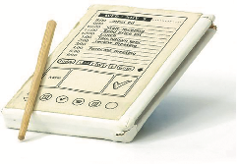
What is a prototype?
One manifestation of a design that allows stakeholders to interact with it
In other design fields, a prototype is a small-scale model:
A miniature car
A miniature building or town
Source: PalmPilot wooden model © Mark Richards

Slide 5
3D Printing Examples
Examples of 3D printing: (a) model jet engine, (b) Spider Dress 2.0 by Anouk Wipprecht, and (c) teddy bear “printed” form a wireframe design
Sources: (a) Build Your Own Jet Engine. Licensed under CC-BY-3.0, (b) arch20, and (c) used courtesy of Scott Hudson

Slide 6
What is a prototype in interaction design?
In interaction design, a prototype can be (among other things):
A series of screen sketches
A storyboard, for example, a cartoon-like series of scenes
A PowerPoint slide show
A video simulating the use of a system
A lump of wood (for instance, the PalmPilot)
A cardboard mock-up
A piece of software with limited functionality written in the target language or in another language

Slide 7
Why prototype?
Evaluation and feedback are central to interaction design
Stakeholders can see, hold, and interact with a prototype more easily than a document or a drawing
Team members can communicate effectively
Ideas can be tested out
Prototyping encourages reflection: an important aspect of design
Prototypes answer questions and support designers in choosing between alternatives

Slide 8
Low-fidelity Prototyping
Uses a medium which is unlike the final medium, for example, paper or cardboard
Is quick, cheap, and easily changed
Examples:
Sketches of screens, task sequences, and so on
‘Post-it’ notes
Storyboards
‘Wizard-of-Oz’

Slide 9
Storyboards
It is a series of sketches showing how a user might progress through a task using the product
Often used with scenarios, bringing in more detail and a chance to role play

Slide 10
Example storyboard

Slide 11
Sketching
Low-fidelity prototyping often relies on sketching
Don’t be inhibited about drawing ability — Practice simple symbols
14

Slide 12
Prototyping with index cards
Index cards (3 x 5 inches)
Each card represents one element of interaction
In evaluation, can step through the cards
15

Slide 13
‘Wizard-of-Oz’ prototyping
The user thinks they are interacting with a computer, but a human is responding to output rather than the system
Usually done early in design to understand users’ expectations
What is ‘wrong’ with this approach?
User
>Blurb blurb
>Do this
>Why?

Slide 14
High-fidelity prototyping
Uses materials that you would expect to be in the final product
Prototype looks more like the final system than a low-fidelity version
High-fidelity prototypes can be developed by integrating existing hardware and software components
Danger that users think they have a complete system…see compromises

Slide 15
Compromises in prototyping
Prototyping involve compromises
For software-based prototyping, maybe there is a slow response? sketchy icons? limited functionality?
“In the wild” prototypes operational but not necessarily robust
Two common types of compromise:
Horizontal: Provides a wide range of functions, but with little detail
Vertical: Provides a lot of detail for only a few functions
Compromises in prototypes must not be ignored. Product needs engineering

Slide 16
Conceptual design
A conceptual model is an outline of what people can do with a product and what concepts are needed to understand and interact with it
Understand problem space and current requirements; empathize with users
Creativity and brainstorming techniques
Mood board may capture desired feel
Consider alternatives: scenarios and prototyping helps

Slide 17
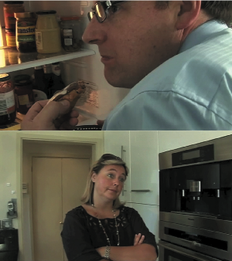
Building scenarios

Slide 18
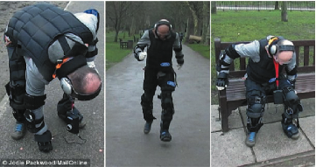
Empathizing with users
The Third Age Suit
Source: Ford Motor Company

Slide 19
Choosing an interface metaphor
Interface metaphors combine familiar knowledge with new knowledge in a way that will help the user understand the product.
Three steps: understand functionality, identify potential problem areas, and generate metaphors
Evaluate metaphors:
How much structure does it provide?
How much is relevant to the problem?
Is it easy to represent?
Will the audience understand it?
How extensible is it?

Slide 20
Considering interaction and interface types
Which interaction type?
How the user invokes actions
Instructing, conversing, manipulating, exploring, or responding
Do different interface types provide insight?
Shareable, tangible, augmented reality, and so forth

Slide 21
Expanding the initial conceptual model
What functions will the product perform?
What will the product do and what will the human do?
How are the functions related to each other?
Sequential or parallel?
Categorizations, for example, all actions related to privacy on a smartphone
What information is needed?
What data is needed to perform the task?
How is this data to be transformed by the system?

Slide 22
Concrete design
Difference between conceptual and concrete is emphasis
Many aspects to concrete design
Color, icons, buttons, interaction devices, and so on
User characteristics and context
Inclusiveness, input, and output modes
Accessibility
Web Content Accessibility Guidelines
Cross-cultural design
Language, colors, icons, and information architecture
Indigenous knowledge and perspectives

Slide 23
Generating prototypes
Generate a storyboard from a scenario
Break down scenario into steps
Create a scene for each step
Sketching out a storyboard prompts designers to think about design issues
Generate a card-based prototype from a storyboard or from a use case
Consider each step in use case – what interaction element is needed
Draw a card that captures it

Slide 24
Generating storyboard

Slide 25
Generating card-based prototype

Slide 26
Explore the user’s experience
Use personas, card-based prototypes, or stickies to model the user experience
Visual representation called:
Design map
Customer or user journey map
Experience map
Two common representations
Wheel
Timeline
27

Slide 27
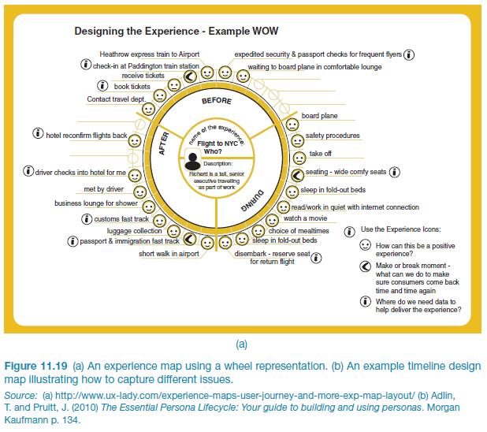
An experience map drawn as a wheel
Source: LEGO
28

Slide 28
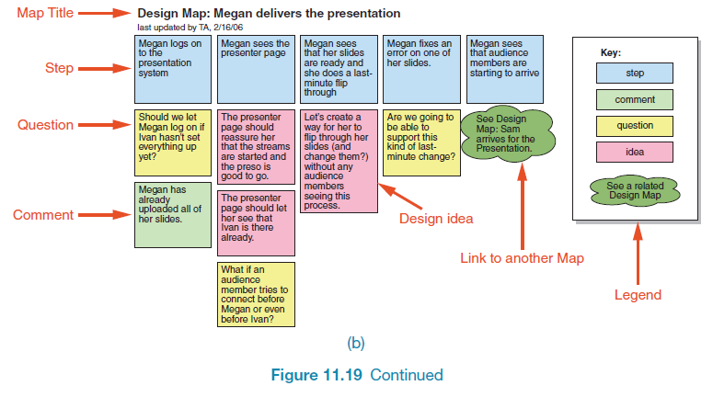
An experience map drawn as a timeline
Source: Adlin and Pruitt (2010), p134. Used courtesy of Morgan Kaufmann.
29

Slide 29
Construction: Physical computing
Build and code prototypes using electronics
Toolkits available include
Arduino
LilyPad (for fabrics)
Senseboard
BBC micro:bit
MaKey MaKey
Designed for use by wide range of people
30

Slide 30
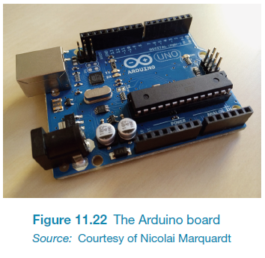
Physical computing kits
The Arduino board
Source: Used courtesy of Dr. Nicolai Marquardt
31

Slide 31
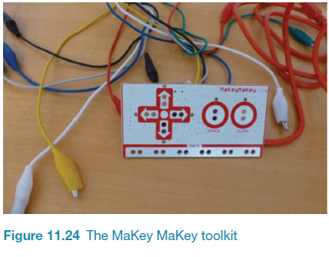
Physical computing kits
The Makey Makey toolkit
Source: Makey Makey
32

Slide 32
Physical computing kits
The BBC micro:bit
Source: micro:bit. Used courtesy of Micro:bit Foundation
33

Slide 33
Construction: SDKs
Software Development Kits
Programming tools and components to develop for a specific platform, for example, iOS
Includes: IDE, documentation, drivers, sample code, and application programming interfaces (APIs)
Makes development much easier
Examples:
Amazon’s Alexa Skills Kit for voice-based services
Apple’s ARKit for augmented reality
Microsoft’s Kinect SDK for motion tracking
34

Slide 34
Summary
Prototyping may be low fidelity (such as paper-based) or high fidelity (such as software-based)
Existing software and hardware helps create prototypes
Two aspects to design: conceptual and concrete
Conceptual design develops an outline of what users can do and what concepts are needed to understand the product.
Concrete design specifies design details, for example, layout or navigation

Slide 35
Summary (continued)
Three approaches to develop an initial conceptual model: interface metaphors, interaction styles, and interface styles.
Expand an initial conceptual model by considering whether product or user performs each function, how those functions are related, and what information is required to support them
Generate prototypes from scenarios and use cases
Physical computing kits and software development kits facilitate the transition from design to construction

